Slide 1
Visualizing Brain Activity Where and How Much for Simple Contrasts
PSYC6135
Michael Truong

Slide 2
Today’s Plan
What is the problem?
How can we try to solve this problem?
How can we test our solution to this problem?

Slide 3
What is the problem?

Slide 4
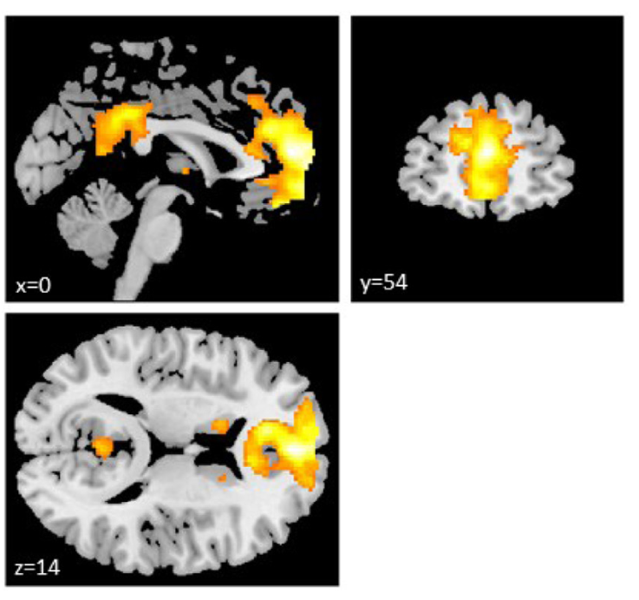
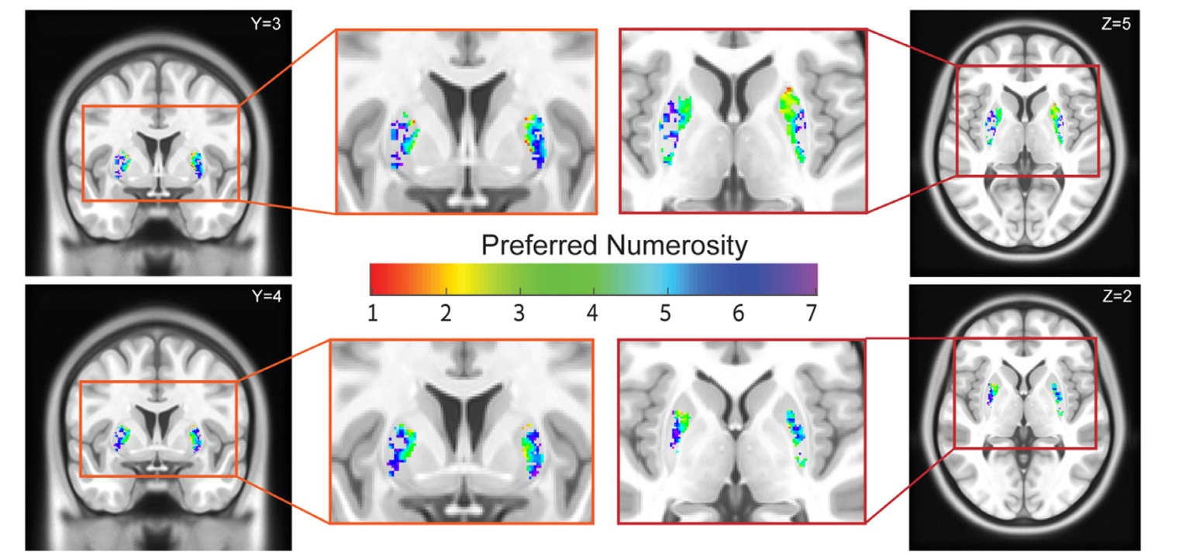
The Problem Shown - 1
Neuroimage 2021
Neuroimage 2021
Notes:
Where – numbers are unhelpful without training

Slide 5
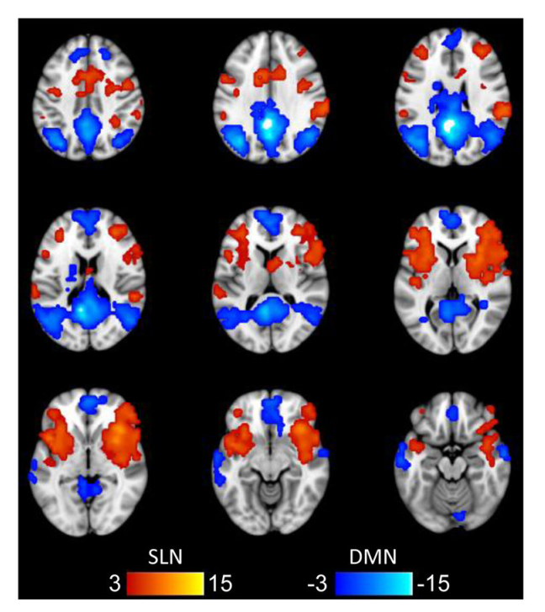
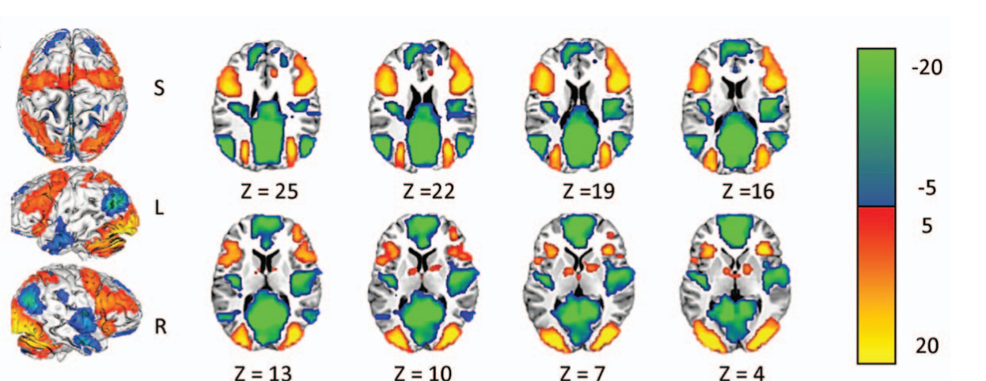
The Problem Shown - 2
Psychology and Aging 2014
Neuropsychologia 2016
Notes:
Volume of activation is particularly difficult

Slide 6
The Problem Written
Volume of activation?
Where?

Slide 7
What is my proposed solution?

Slide 8
Proposed Solution – Go 3D/4D!
Article = Image + reference to animation
Image Features:
Opacity
Animated Features:
Motion
Confidence Intervals
Exploding Diagram

Slide 9
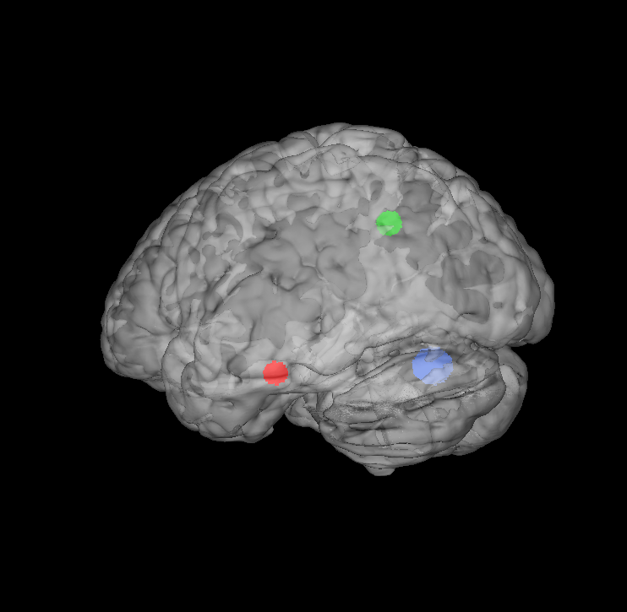
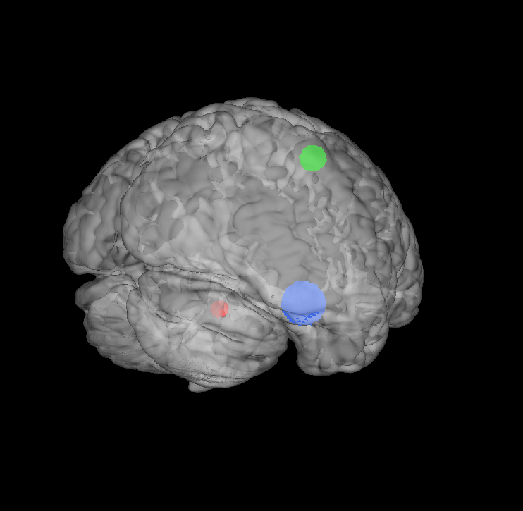
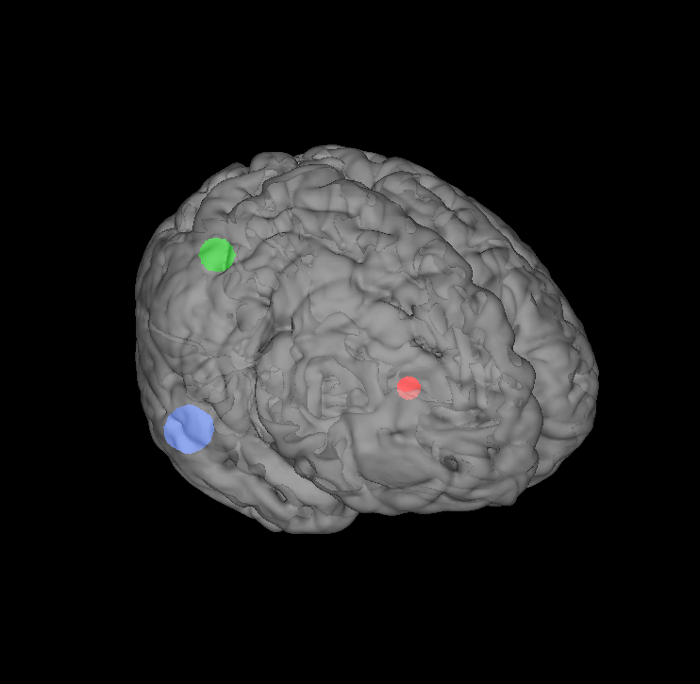
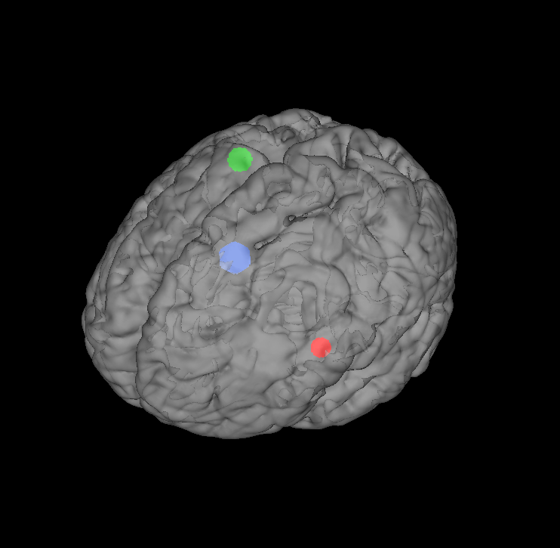
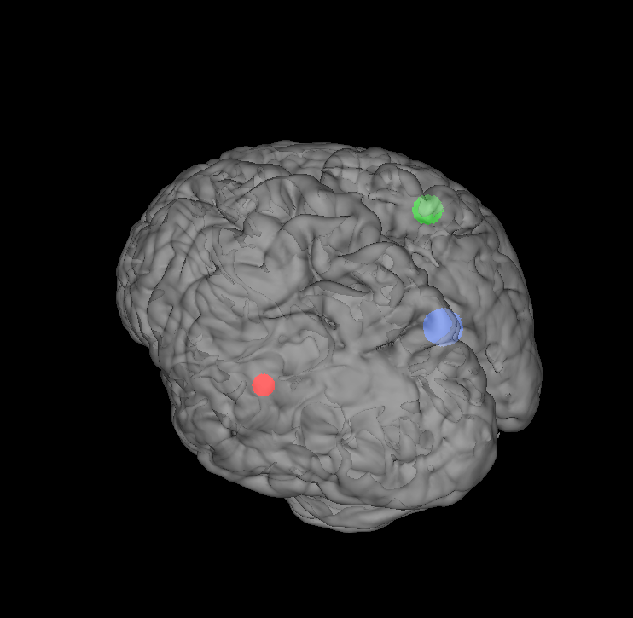
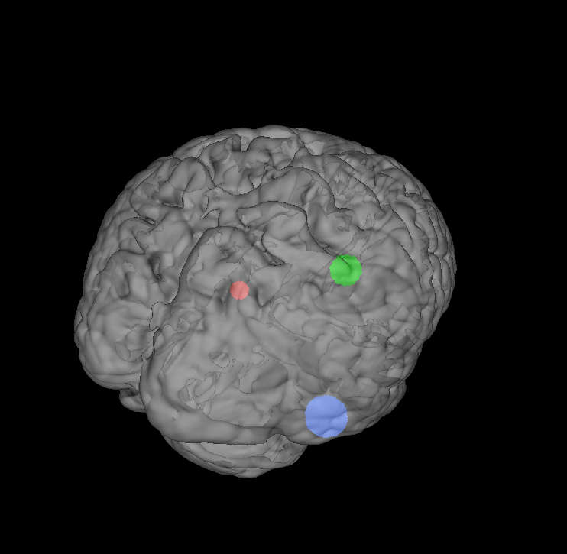
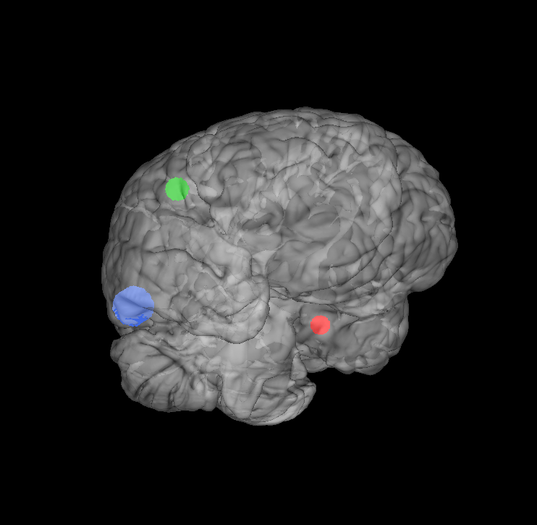
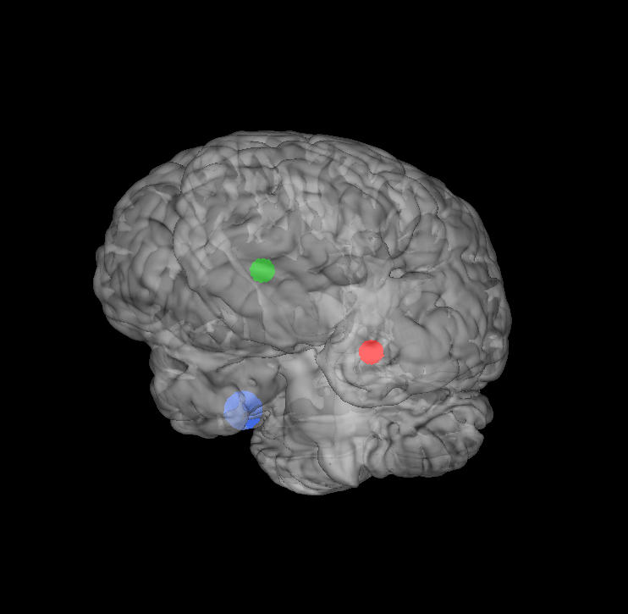
Static
Made using Mango software (Jack L. Lancaster and Michael J. Martinez)
Notes:
Made using Mango
- The hope is that by providing both multiple views that give 3d information on where the activation is, it will hopefully be easier to identify where the activation is.

Slide 10
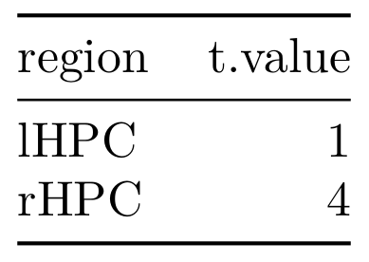
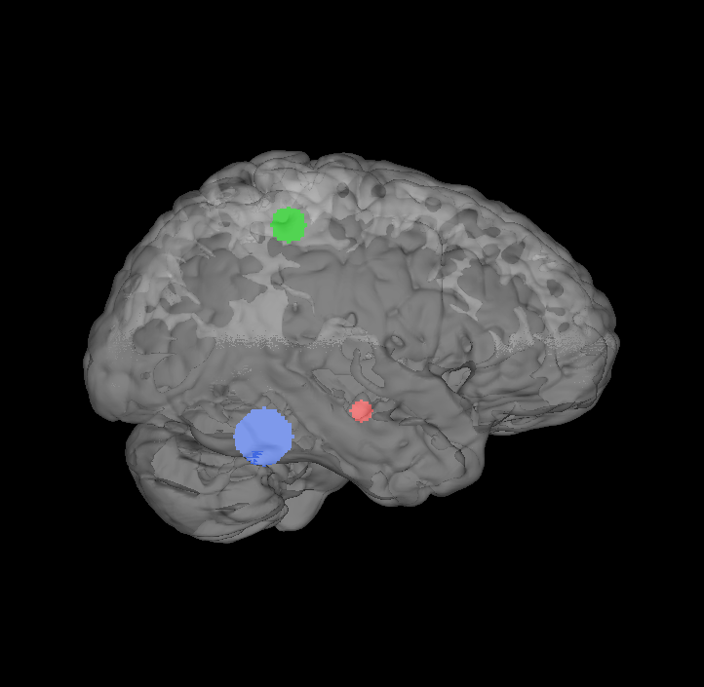


Animated
Made using Mango software and qrCode R package
Encoding
Retrieval
Notes:
QR Code allows shareability during conferences
Is also hopefully more durable than URLs
Shiny allows individual interactability, so that people can answer the questions that they’re interested in. It also helps them control what visualization features are most pressing for their question

Slide 11
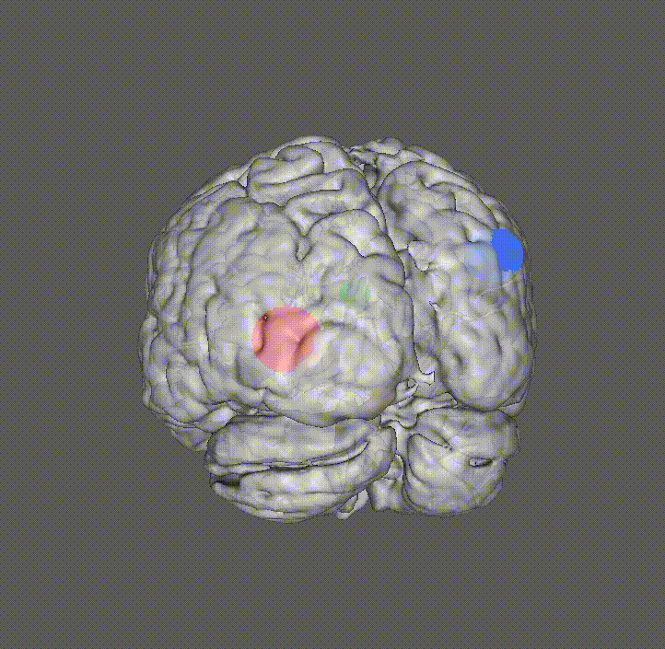
Illustration: Variable Opacity and Motion
Made using Mango
Notes:
Motion hopefully gives more points of view of where the 3d thing is. And the variable opacity hopefully helps discern between cortical and subcorticalactivation better – perhaps it can also improve the sense of depth.
Unfortunately, this visualization doesn’t represent the subcortical regions such as the limbic areas like the hippocampus and thalamus.
It also does not show the statistical values, but instead just a solid color, but this is more of my fault than Mango – Mango is able to do this, but I was not able to figure it out in time for the presentation.

Slide 12


Illustration: Confidence Intervals via Color
Made using ggAnimate and colorspace R packages
Notes:
Typically, confidence intervals are not shown for the estimates of activation because it is only ever in 2 or 3d. The hope is that with 4D, you can see the stability of the estimate through the range of colors (which are stand-ins for values) that the voxel runs through.

Slide 13
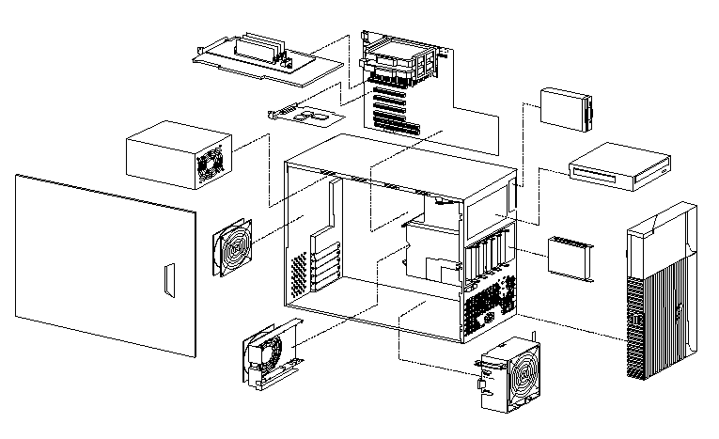
Illustration: Exploded Diagrams
From https://www.ibm.com/support/pages/computer-exploded-view-ibm-intellistation-z-pro-type-6866
Notes:
You can use exploded diagrams to parse out clusters of activity within a volume of activation better. Perhaps you might want to cluster together regions based on the stability of their estimates, or so-on.

Slide 14
Summary of Proposed Innovations
Static
Volumes of activation
Animated
Interactivity
Shareability
Estimate stability
Within volume clustering

Slide 15
How can we benchmark my proposed solution?

Slide 16
Experimental Comparison
Area identification
Speed
Accuracy
Is DV different while seeing image? With delay?
Which is better, phenomenologically?

Slide 17
Conclusion

Slide 18
Summary
Current visualizations are impoverished and difficult to imagine
Tackled here using 3D/4D approaches
Experimental comparison via area identification task
Are the benefits enough to outweigh 3D/4D’s drawbacks?

Slide 19
References
Anderson, J. A. E., Campbell, K. L., Amer, T., Grady, C. L., & Hasher, L. (2014). Timing is everything: Age differences in the cognitive control network are modulated by time of day. Psychology and Aging, 29(3), 648–657. https://doi.org/10.1037/a0037243
Computer exploded view—IBM IntelliStation Z Pro (Type 6866). (2001, December 20). [CT741]. https://www.ibm.com/support/pages/computer-exploded-view-ibm-intellistation-z-pro-type-6866
Grady, C. L., Luk, G., Craik, F. I. M., & Bialystok, E. (2015). Brain Network Activity in Monolingual and Bilingual Older Adults. Neuropsychologia, 66, 170–181. https://doi.org/10.1016/j.neuropsychologia.2014.10.042
Hofstetter, S., & Dumoulin, S. O. (2021). Tuned neural responses to haptic numerosity in the putamen. NeuroImage, 238, 118178. https://doi.org/10.1016/j.neuroimage.2021.118178
Sellitto, M., Neufang, S., Schweda, A., Weber, B., & Kalenscher, T. (2021). Arbitration between insula and temporoparietal junction subserves framing-induced boosts in generosity during social discounting. NeuroImage, 238, 118211. https://doi.org/10.1016/j.neuroimage.2021.118211

